Slide 1
Alibaba Cloud Global AI Innovation challenge
Team Name: AI_IDEA HITESH
Team Members: HITESH SHARMA

Slide 2
Problem Statement
We are heading towards a major crisis. The crisis related to food shortage. Experts say that by 2050, Earth’s population is set to grow by 2 billion and the conventional ways of farming will not leave us with enough ways to feed the entire population.
As per UN Food and Agricultural Organization (FAO), the global population will reach 9.2 billion (by the year 2050). In order to feed this crazy growth in people, there has to be a miracle.

Slide 3
Idea Description
There is a need to go from small farming to smart farming. If Machine Learning, an algorithm that absorbs and analyzes a huge volume of data in order to ascertain common patterns and in turn transforms those patterns into predictions. In agriculture, it can prevent wastage and damage.

Slide 4
Strategies
Using soil maps, farmers can pursue two strategies to adjust field inputs:
Predictive approach: based on analysis of static indicators (soil, resistivity, field history, etc.) during the crop cycle.
Control approach: information from static indicators is regularly updated during the crop cycle by : sampling: weighing biomass, measuring leaf chlorophyll content, weighing fruit, etc.
remote sensing: measuring parameters like temperature (air/soil), humidity (air/soil/leaf), wind or stem diameter is possible thanks to Wireless Sensor Networks and Internet of things (IoT)
proxy-detection: in-vehicle sensors measure leaf status; this requires the farmer to drive around the entire field.
aerial or satellite remote sensing: multispectral imagery is acquired and processed to derive maps of crop biophysical parameters, including indicators of disease. Airborne instruments are able to measure the amount of plant cover and to distinguish between crops and weeds

Slide 5
USE of AI in Project
There can be real-time insights about crops produce with the help of sensors, in-field cameras, and micro weather data. Early signs of damage to the crop can be detected and addressed with the help of deep learning and computer vision algorithms.
There might be a number of crop related issues that can skip the eyes of humans but can be detected with the help of proven and well-trained algorithms. There are smart sensors to detect the following:
Rainfall
Humidity
Crop water demand
Water stress
Microclimate data
Canopy biomass
Chlorophyll

Slide 6
USE of ML in Project
Machine learning is commonly used in conjunction with drones, robots, and internet of things devices. It allows for the input of data from each of these sources.
The computer then processes this information and sends the appropriate actions back to these devices. This allows for robots to deliver the perfect amount of fertilizer or for IoT devices to provide the perfect quantity of water directly to the soil.
Machine learning may also provide predictions to farmers at the point of need, such as the contents of plant-available nitrogen in soil, to guide fertilization planning. As more agriculture becomes ever more digital, machine learning will underpin efficient and precise farming with less manual labour .

Slide 7
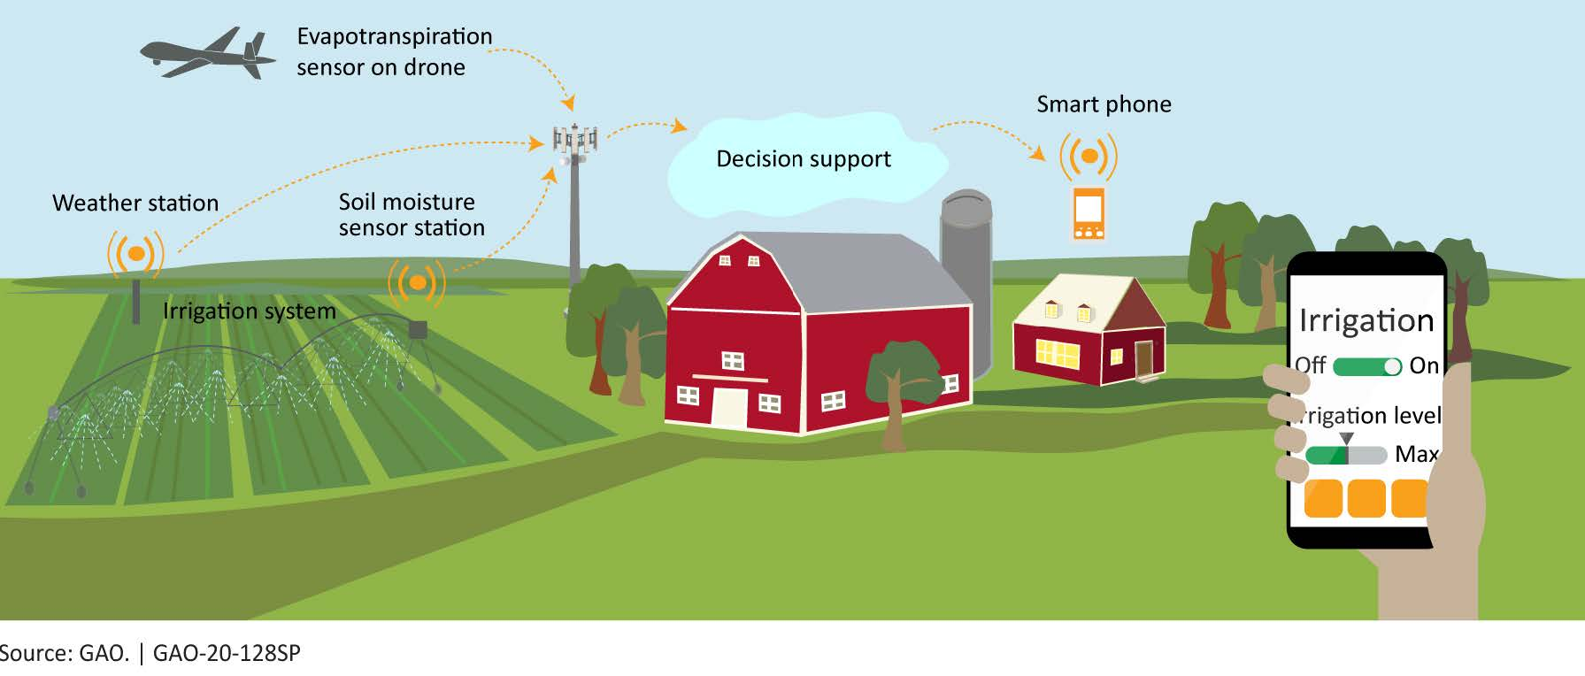
USE of AI or ML

Slide 8
Economic and environmental impacts
Precise and correct amount of inputs like water, fertilizer, pesticides etc. at the correct time to the crop for increasing its productivity and maximizing its yields .
Reduces the pressure on agriculture for the environment by increasing the efficiency of machinery and putting it into use.
For example, the use of remote management devices such as GPS reduces fuel consumption for agriculture, while variable rate application of nutrients or pesticides can potentially reduce the use of these inputs, thereby saving costs and reducing harmful runoff into the waterways

Slide 9

Work On

Slide 10
About DataSet
We have the Indian Data Taken from data.gov
The One Dataset comprise of rainfall, temperature,Ph of soil and respective production.
Another dataset Consist of temprainfall data where entries are made according to the different state in India.
Dataset also have attribute crop as different crop have different ph, rainfall, temp required .

Slide 11
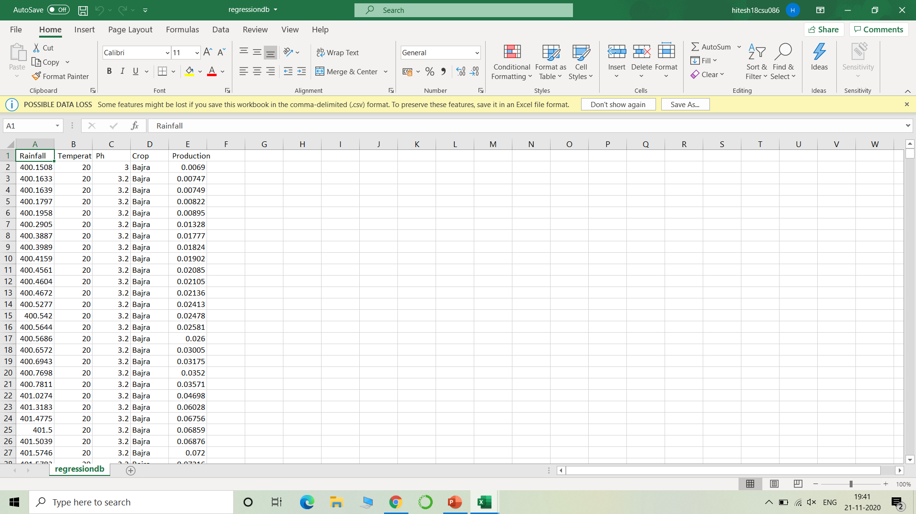
Dataset ScreenShot

Slide 12
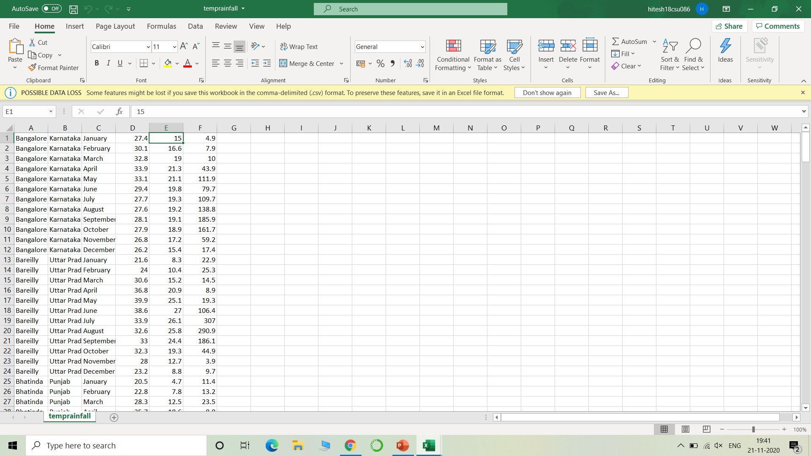
Dataset ScreenShot

Slide 13
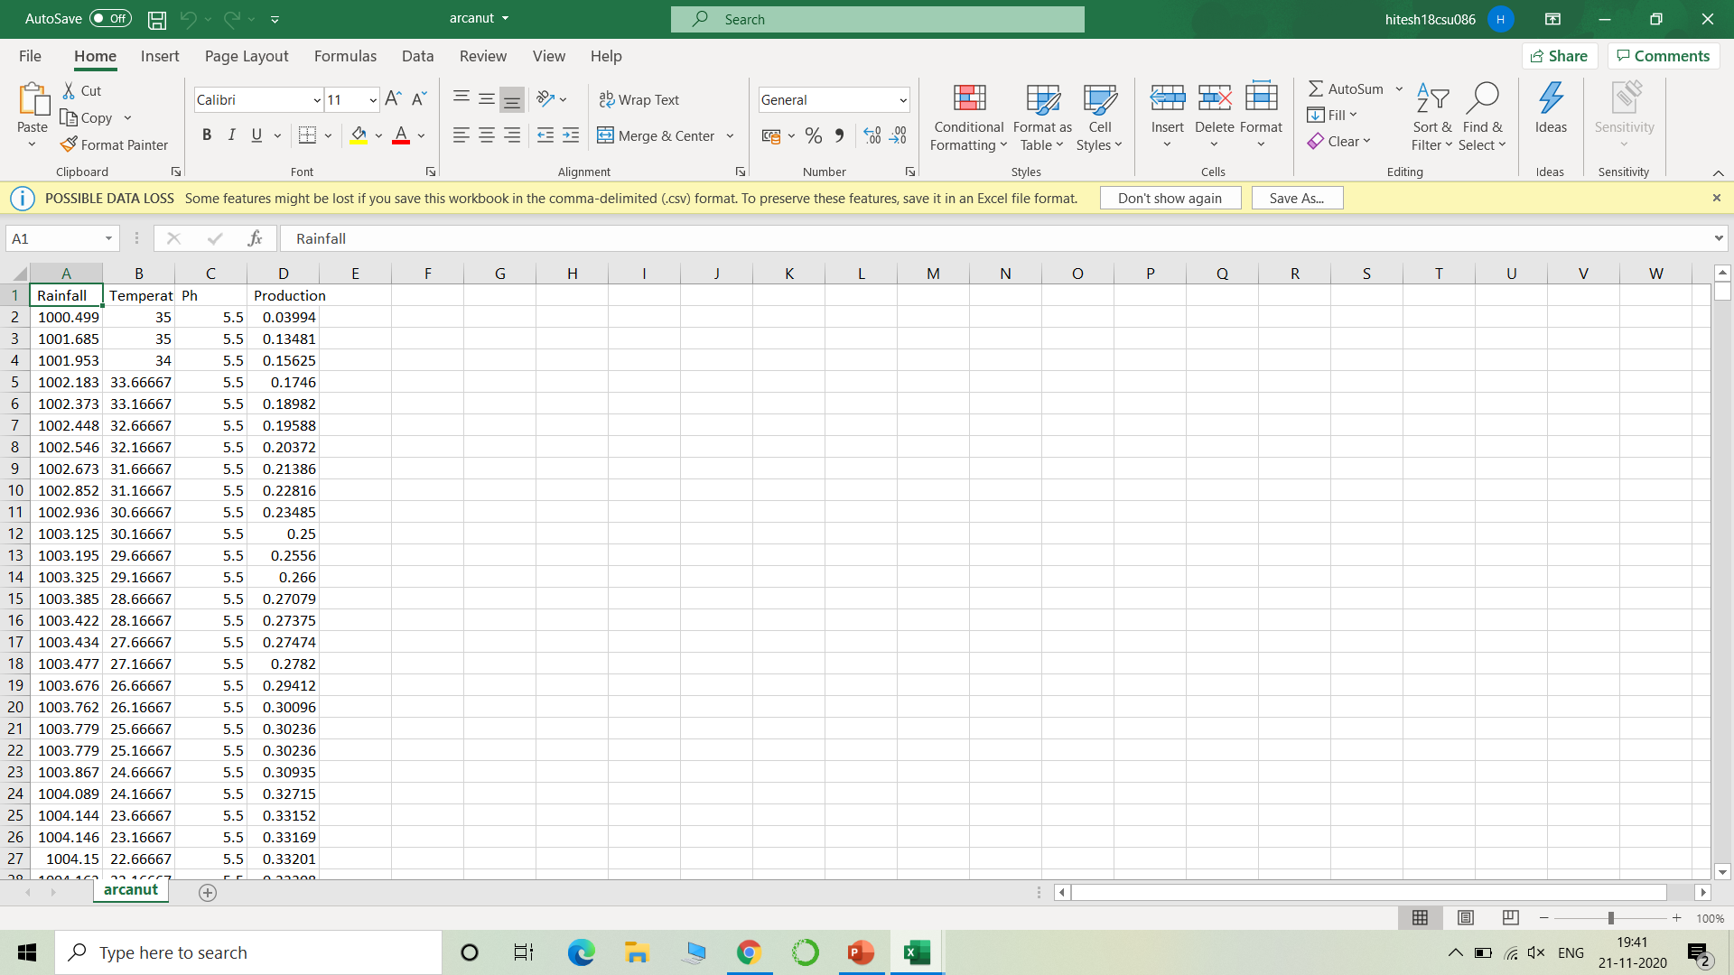
Dataset ScreenShot

Slide 14
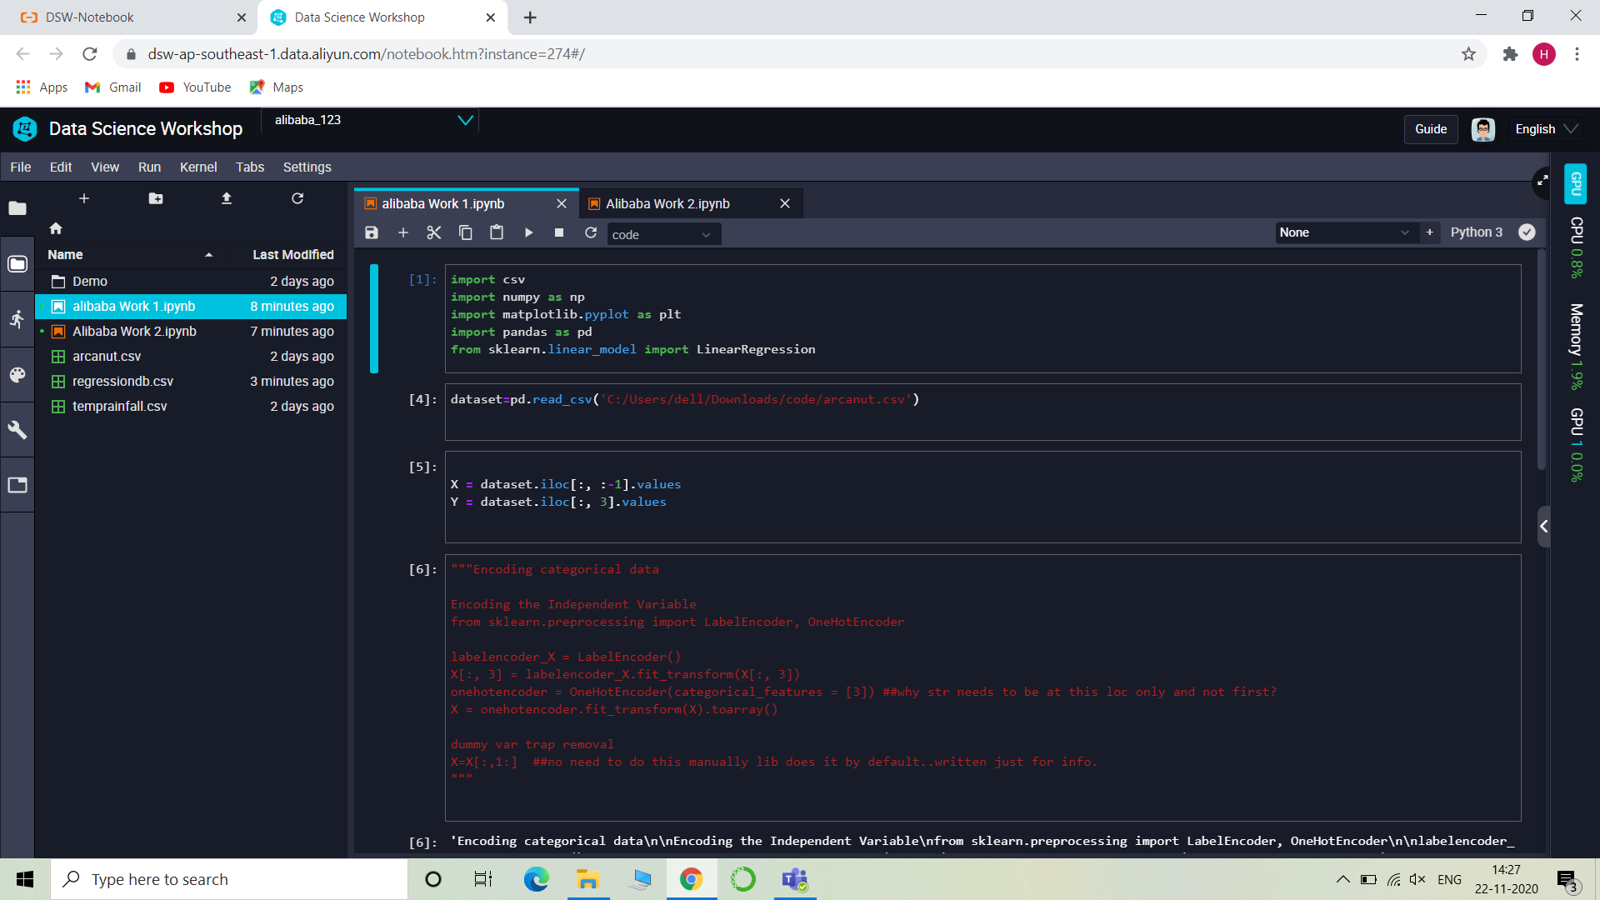
PYTHON CODE ON ALIBABA CLOUD PLATFORM (PAI NOTEBOOK)

Slide 15
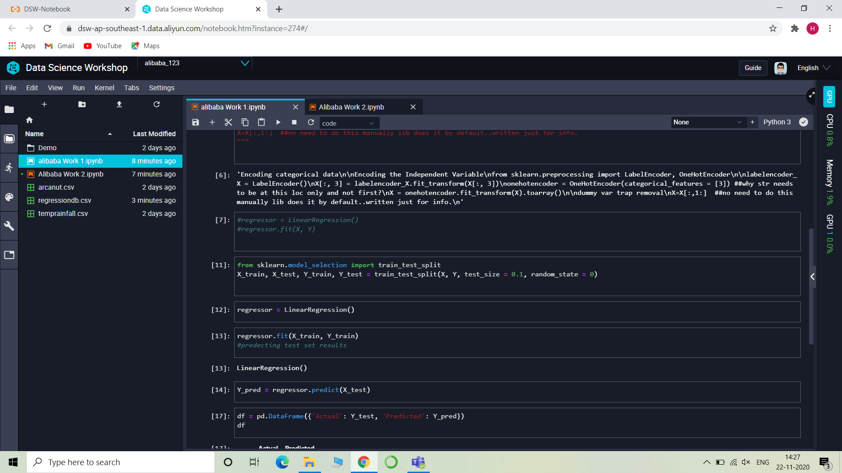
ScreenShots of PAI Notebook

Slide 16
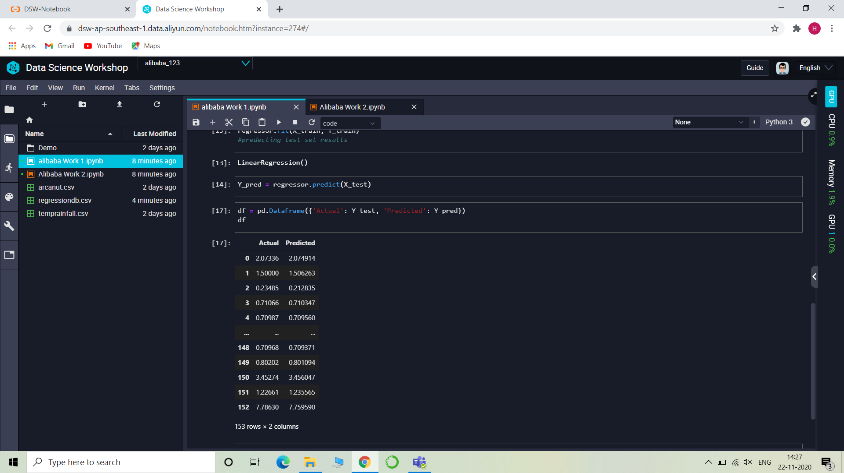
ScreenShots of PAI Notebook

Slide 17
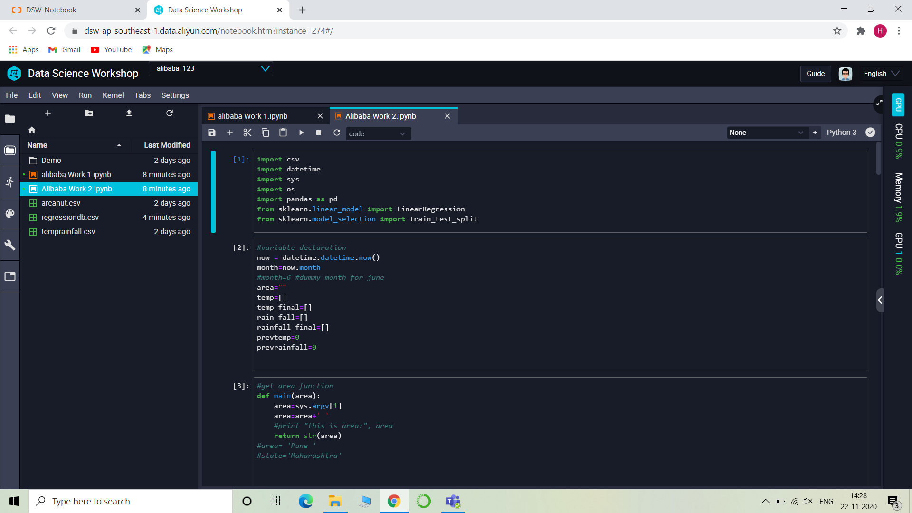
ScreenShots of PAI Notebook

Slide 18
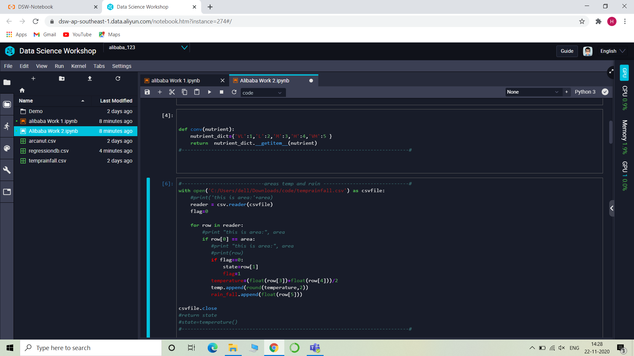
ScreenShots of PAI Notebook

Slide 19
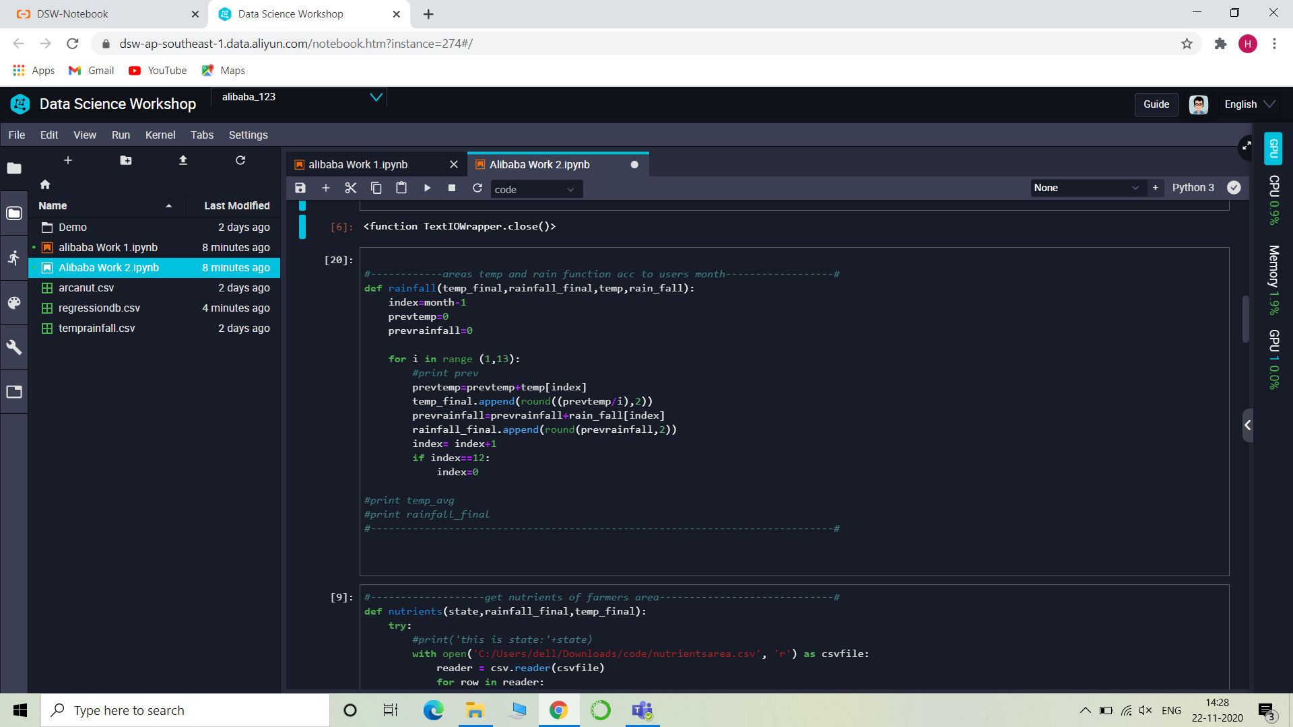
ScreenShots of PAI Notebook

Slide 20
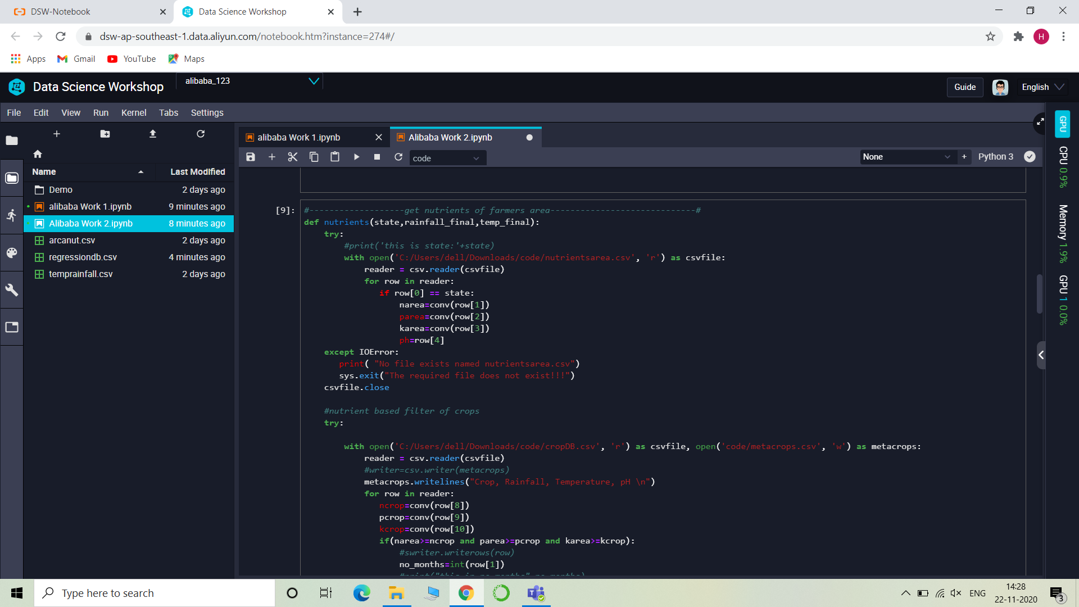
ScreenShots of PAI Notebook

Slide 21
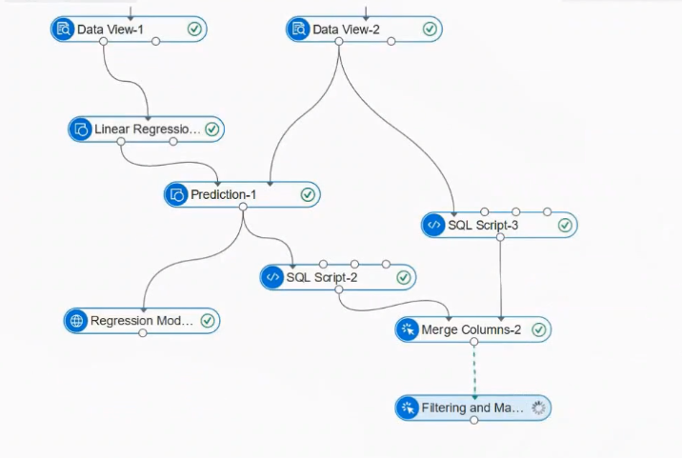
2. A file showing you have used PAI Nodes for project

